Slide 1

Software quality control techniques
Fault avoidance: prevents errors before the system is released.
reviews, inspections, walkthroughs, development methodologies, testing, verification
Fault tolerance: enables the system to recover from (some classes of) errors by itself.
rollbacks, redundancy, mirroring

Slide 2
Verification & Validation
Verification is the process of evaluating a system or component to determine whether the products of a given development phase satisfy the conditions imposed at the start of that phase.
Are we building the product right?
Testing, Reviews
Validation is the process of evaluating a system or component during or at the end of the development process to determine whether it satisfies specified requirements.
Are we building the right product?
Comparison against requirements

Slide 3
Terminology
Mistake – a human action that produces an incorrect result.
Fault [or Defect] – an incorrect step, process, or data definition in a program.
Failure – the inability of a system or component to perform its required function within the specified performance requirement.
Error – the difference between a computed, observed, or measured value or condition and the true, specified, or theoretically correct value or condition.

Slide 4

Exception or error output expected
Error
Overflow / crash
Failure
int factorial(int a){
if(a==1)
return 1;
return a* factorial(a-1);
}
Lack of input validation
Defect: missing validation
Mistake: Did not consider numbers less than 1

Slide 5
Software Testing
Software testing is the process of analyzing a software item to detect the differences between existing and required conditions (i.e., bugs) and to evaluate the features of the software item.

Slide 6
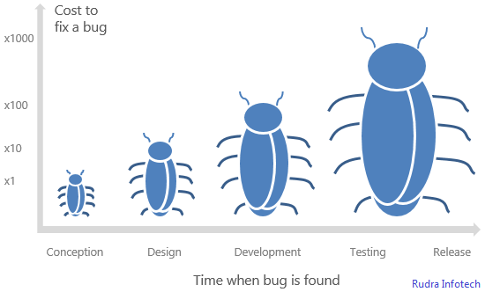
When should we test software?
Answer: Throughout the whole development process

Slide 7
Testing goals
Write test cases to cause failures.
But, there is no way to guarantee that all faults have been detected.
Work smart: write as few test cases as possible to cause failures; don’t have more than one test cause the same failure

Slide 8
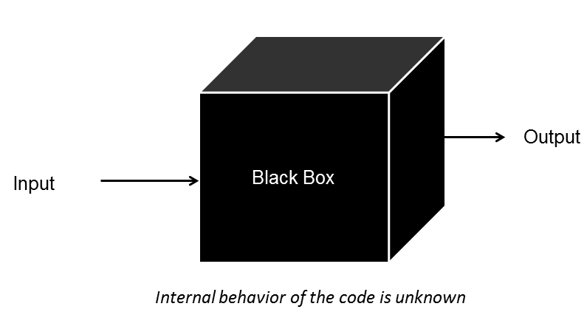
Testing model: Black box testing
Black box testing: ignores the internal mechanism of a system or component and focuses solely on the outputs generated in response to selected inputs and execution conditions.
Interface visible, internals unknown
You know what it is supposed to do, you design tests that make it do what you think that it should do
From the outside, you are testing its functionality against the specs
For software this is testing the interface
What is input to the system?
What you can do from the outside to change the system?
What is output from the system?
Tests the functionality of the system by observing its external behavior
No knowledge of how it goes about meeting the goals

Slide 9
Advantages of Black box testing
Process is not influenced by component being tested
Assumptions embodied in code not propagated to test data.
Robust with respect to changes in implementation
Test data need not be changed when code is changed
Allows for independent testers
Testers need not be familiar with code
Useful for validation (are we building the right software)

Slide 10
Disadvantages of Black box testing
It will miss bugs in the implementation that are not covered by the specification
Control-flow details
Performance optimizations
Alternate algorithms for different cases

Slide 11
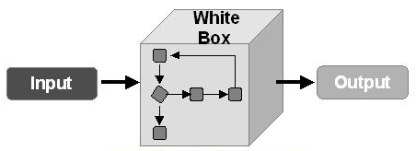
Testing model: White box testing
White box testing takes into account the internal mechanisms of a system or component.
Given knowledge of the internal workings, you thoroughly test what is happening on the inside
Close examination of procedural level of detail
Logical paths through code are tested
Conditionals
Loops
Branches
Status is examined in terms of expected values

Slide 12
Advantages of White box testing
Finds an important class of boundaries.
Yields useful test cases.
Very useful to examine and test important data structures
Useful for verification (are we building the software right)

Slide 13
Disadvantages of White box testing
Tests may have the same bugs as implementation!
Impossible to thoroughly exercise all paths
Exhaustive testing grows without bound

Slide 14
Types of testing
Six types of testing
Unit testing
Integration testing
Non-functional testing
Acceptance testing
Regression testing
Beta testing

Slide 15

Unit testing
Testing of individual hardware or software units or groups of related units
Done by programmer(s)
Generally all white box
Verify that code does what it is intended to do at a very low structural level
Automation desirable for repeatability

Slide 16

Integration testing
Testing in which software components, hardware components, or both are combined and tested to evaluate the interaction between them
Done by programmer as they integrate their code into code base
Verifies that units work together when they are integrated into a larger code base
Just because the components work individually, that does not meant that they all work together when integrated
Generally white box, maybe some black box
Automation desirable for repeatability

Slide 17

Non-Functional testing
Testing conducted on a complete, integrated system to evaluate the system compliance with its specified requirements
Stress testing: evaluating a system beyond the limits of its specification
Performance/load testing: evaluating the compliance of a system with specified performance requirements.
Usability testing: evaluating the extend to which a user can learn to operation, prepare inputs for, and interpret outputs of a system.
It is recommended that this be done by external test group
Mostly black box so that testing is not ‘corrupted’ by too much knowledge

Slide 18


Acceptance testing
Formal testing conducted to determine whether or not a system satisfies its acceptance criteria (the criteria the system must satisfy to be accepted by a customer) and to enable the customer to determine whether or not to accept the system
Generally done by customer/customer representative in their environment through the GUI
Definitely black box

Slide 19

Regression testing
Regression testing is selective retesting of a system or component to verify that modifications have not caused unintended effects and that the system or component still complies with its specified requirements
Subset of the original set of test cases.
Core group of tests re-run often after any significant changes
Choose a representative sample of tests that exercise all the existing functionalities
Chose additional test cases that are most likely to be affected by the change
Smoke test: a subset of the regression test cases that establish that the system is stable and all major functionality is present and works under “normal” conditions

Slide 20

Beta testing
Organization can offer an advance partial or full version of a software package free to one or more potential users.
Users use the software as they wish, with the understanding that they will report any errors revealed during usage back to the organization.
Advantages
Identification of unexpected errors
Low costs
Wider population / environment
Disadvantages
Lack of systematic testing
Low quality error reports

Slide 21
Testing Hierarchy
Acceptance testing
Non-functional testing
Integration testing
Unit testing
Beta testing
Regression testing

Slide 22
Test plan
Document describing the scope, approach, resources, and schedule of intended testing activities
A test plan identifies
test items
features to be tested
Testing tasks
who will do the testing
any risks requiring contingency plans
Test throughout the development cycle
Write the test plan early in the development cycle
If you wait until the end of the cycle, you might be in a very chaotic, hurried environment

